Slide 1
Monitor Object Pattern
Medet KAT

Slide 2
Definition
In concurrent programming, a monitor is an object intended to be used safely by more than one thread. The defining characteristic of a monitor is that its methods are executed with mutual exclusion. That is, at each point in time, at most one thread may be executing any of its methods. This mutual exclusion greatly simplifies reasoning about the implementation of monitors compared with code that may be executed in parallel.

Slide 3
Structure
There are four participants in the Monitor Object pattern
Monitor object
Synchronized methods
Monitor lock
Monitor condition

Slide 4
Structure
Monitor object: A monitor object exports one or more methods to clients. To protect the internal state of the monitor object from uncontrolled changes or race conditions,all clients must access the monitor object only through these methods.

Slide 5
Structure
Synchronized methods:Synchronized methods implement the thread-safe services exported by a monitor object. To prevent race conditions, only one synchronized method can execute within a monitor at any point in time, regardless of the number of threads that invoke the object’s synchronized methods concurrently or the number of synchronized methods in the object’s class.

Slide 6
Structure
Monitor lock: Each monitor object contains its own monitor lock.Synchronized methods use this monitor lock to serialize method invocations on a per-object basis. Each synchronized method must acquire/release the monitor lock when the method enters/exits the object, respectively.

Slide 7
Structure
Monitor condition:Multiple synchronized methods running in separate threads can cooperatively schedule their execution sequences by waiting for and notifying each other via monitor conditions associated with their monitor object. Synchronized methods use monitor conditions to determine the circumstances under which they should suspend or resume their processing.

Slide 8
Monitor Object
synchronized_method_1()
...
synchronized_method_m()
monitor_lock_
monitor_condition_1_
...
monitor_condition_n_

Slide 9
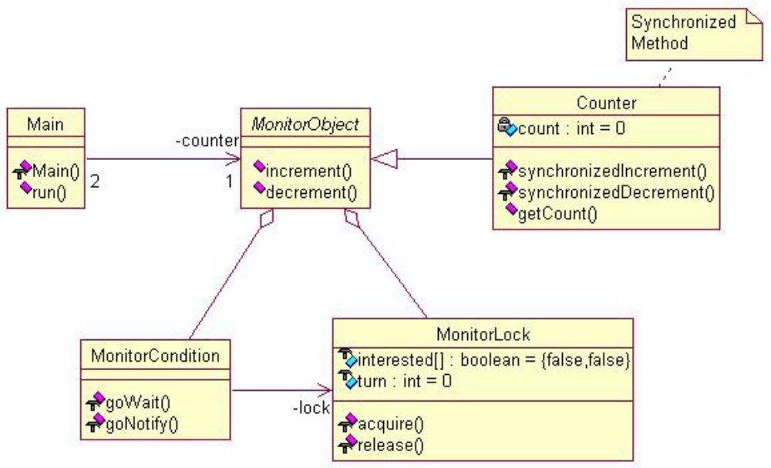
Synchronized Implementation

Slide 10
Implementation
The following steps illustrate how to
implement the Monitor Object pattern.
1. Define the monitor object’s interface methods:The interface of a monitor object exports a set of methods to clients. Interface methods are typically synchronized, i.e., only one of them at a time can execute in a particular monitor object.

Slide 11
Implementation
class Message_Queue
{
public:
enum {
MAX_MESSAGES = /* ... */;
};
Message_Queue (size_t max_messages
= MAX_MESSAGES);
void put (const Message &msg);
Message get (void);
bool empty (void) const;
bool full (void) const;
private:
};

Slide 12
Implementation
2.Define method object’s implementation methods:A monitor object often contains implementation methods that simplify its interface methods. This separation of concerns helps to decouple synchronization and scheduling logic from monitor object functionality, as well as avoid intra-object deadlock and unnecessary locking overhead.

Slide 13
Implementation
class Message_Queue
{
public:
private:
void put_i (const Message &msg);
Message get_i (void);
bool empty_i (void) const;
bool full_i (void) const;
// ...
};

Slide 14
Implementation
3. Define the method object’s internal state:A monitor object contains data members that define its internal state. In addition, a monitor object contains a monitor lock that serializes the execution of its synchronized methods and one or more monitor conditions used to schedule synchronized method execution within a monitor object.

Slide 15
Implementation
class Message_Queue
{
private:
size_t message_count_;
size_t max_messages_;
mutable Thread_Mutex monitor_lock_;
Thread_Condition not_empty_;
Thread_Condition not_full_;
};

Slide 16
Implementation
4. Implement all the monitor object’s methods and data members:The final step involves implementing all the monitor object methods and internal state defined above.
→Initialize the data members: This substep initializes object-specific data members, as well as the monitor lock and any monitor conditions.

Slide 17
Implementation
→Apply the Thread-safe Interface idiom:In this substep,the interface and implementation methods are implementing according to the Thread-safe Interface idiom. Note how this synchronized method only performs the synchronization and scheduling logic needed to serialize access
to the monitor object and wait while the queue is full, respectively.

Slide 18
References
http://www.cs.wustl.edu/~schmidt/PDF/monitor.pdf
http://www.mijnadres.net/published/Monitor%20Object%20Pattern.pdf
http://en.wikipedia.org/wiki/Monitor_%28synchronization%29

Slide 19
Önemli Değil :P

